Slide 1
Sawing and Broaching Processes

Slide 2
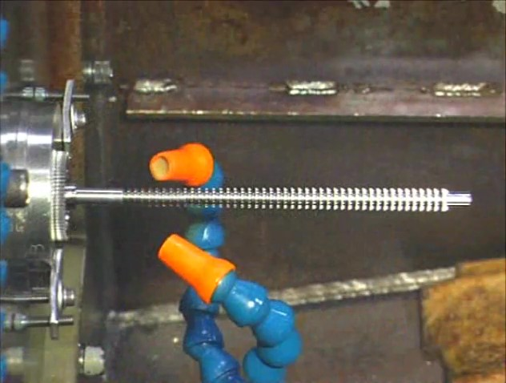
Watch Video Here
Notes:
Gear Broaching

Slide 3
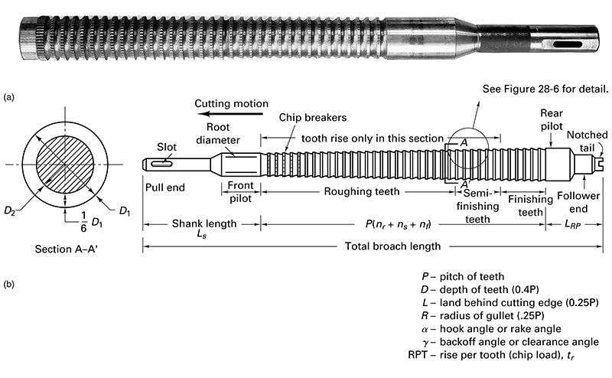
Broach

Slide 4
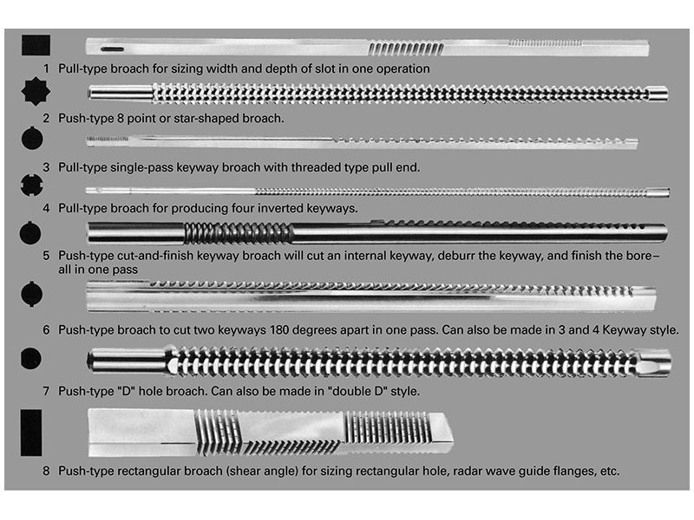
Shapes possible with Broaching

Slide 5
Broach for circular hole

Slide 6
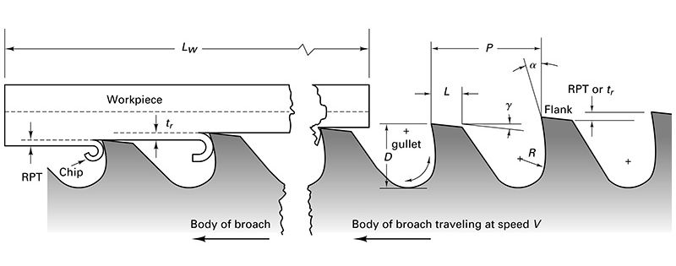
Cutting process with broach

Slide 7
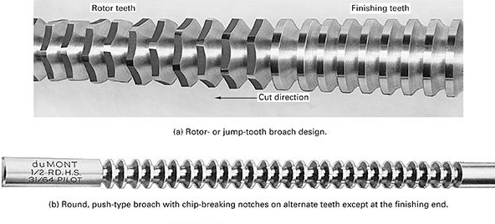
Chip-breaking methods

Slide 8
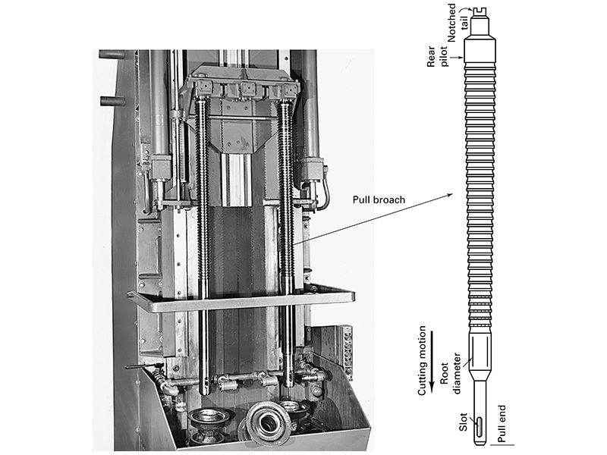
Broaching Machine

Slide 9
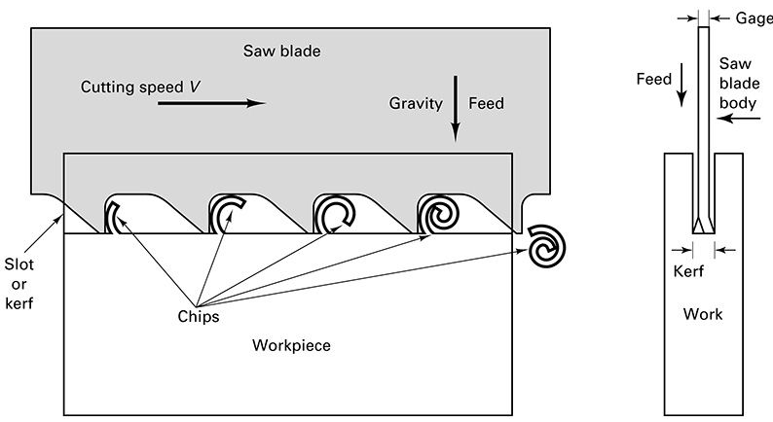
Sawing Action

Slide 10
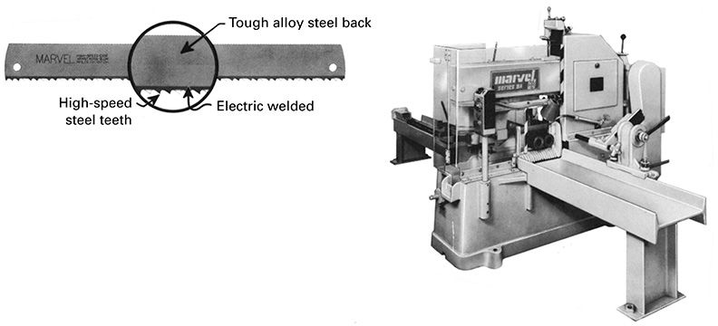
Power Hacksaw

Slide 11
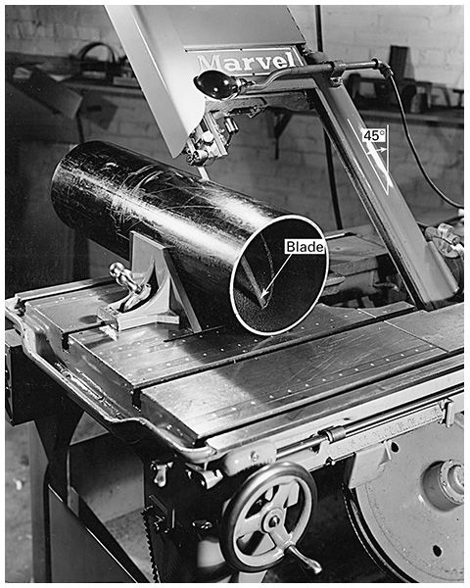
Bandsaw

Slide 12
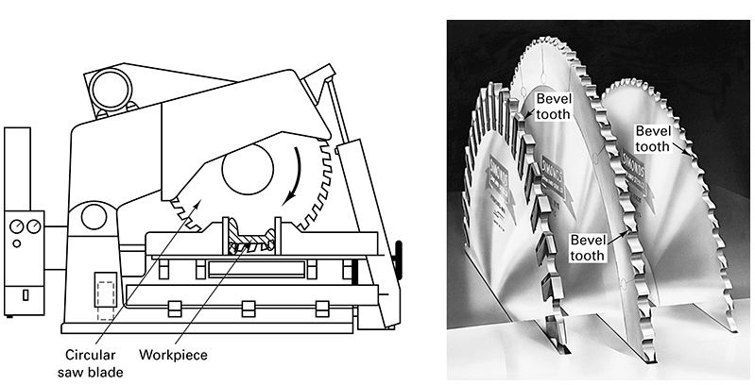
Circular Saw

Slide 13
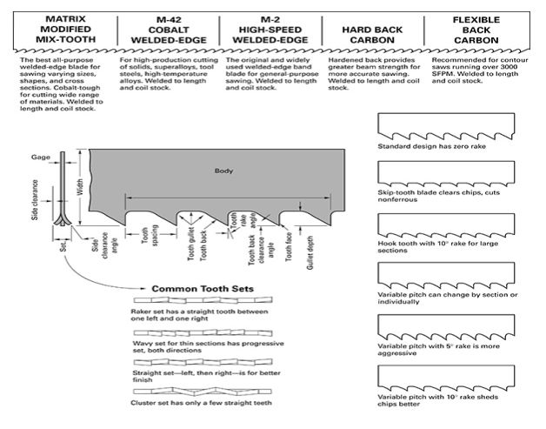
Blade designs and nomenclature

Slide 14
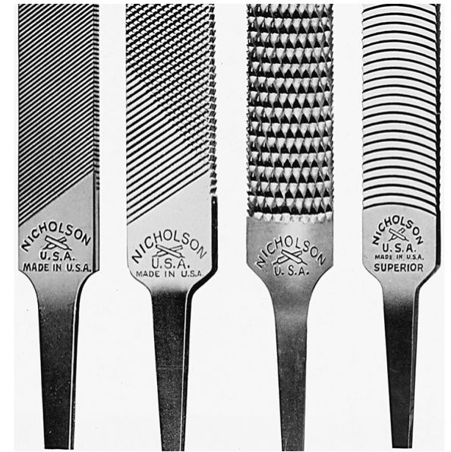
File Types

Slide 15
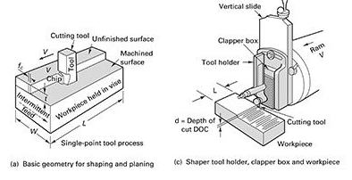
Shaping/Planing Process

Slide 16
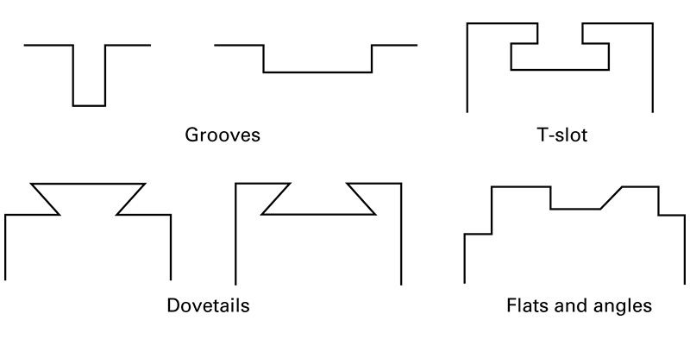
Surface types machined by shaping and planing

